Slide 1
Technical Advisory Group
Hawai’i PBFA Programs
Winter 2018 Meeting
February 28, 2018

Slide 2
TAG Agenda: 9am - 10:45am
Welcome - Ted Pope, EEM
PBFA EM&V/Program Perspectives and Planning – Steve Schiller, EEM
EM&V Report – Opinion Dynamics, Independent EM&V Contractor
Hawai’i Energy Perspectives & Insights on PY2018 Planning – Hawai’i Energy
Summary, Schedule and Discussion – Ted Pope and Steve Schiller, EEM

Slide 3

PBFA EM&V/Program Perspectives and Planning
Steve Schiller, EEM

Slide 4
PBF Programs and EM&V
TAG meeting today is focusing more on EM&V, but EM&V supports programs – all connected
Topics:
PY16, PY17 and PY18 programs – results/status
Related EM&V

Slide 5
Context
Why we do EM&V
Support assessment of compliance with PBFA goals and performance incentives calculations - Provide PROOF of the effectiveness of energy management
Feedback for program design and prioritization of EE actions - Provide data to support efficiency as a reliable resource
Feedback for resource planners and overall EEPS and RPS compliance - “You can’t manage what you don’t measure” and “Things that are measured tend to improve”.

Slide 6

Context
Hawai’i Perspective – balancing cost, time, value
  Appropriate approaches have been used given the scale, scope and nature of PBFA programs
  However some revisiting is perhaps in order with regards to the savings values assigned to measures because:
    Longer than intended time since last major updates to key documents
    Programs and markets have and are changing
    Program budgets reduced, but not goals
    Measures will likely become more complex and probably more expensive
    The RPS has moved to 100% and EE’s (and all DERs’) roles are affected, perhaps with new primary metrics
    Increased recognition of low-income and HTR markets

Slide 7
EM&V Activities – guiding input
Primary activity has been PY16 verification….but also considered:
  Past EM&V reports and activities/budgets (including historic very high ~100% verification results)
  Commission decisions, such as Order 34370, 02/17, that for example called for review of:
    Peer program analyses
    Updating of system loss factors
  Prior TAG (and TWG) feedback, for example:
    HECO needs more granular data on location and timing of EE, EE forecasts, as well as new potential/baseline documents
    KIUC is looking for data/support on addressing additional air conditioning loads

Slide 8
EM&V Activities – CY 2017 & 2018
We identified several areas of focus for the short term:
  Verifications:
    Complete PY16 verification (completed)
    Initiate PY17 verification (to be initiated)
  Comprehensive Longitudinal Effects Study(completed)
  Potential overlaps and other programmatic issues review (completed)
  Review of TRM changes suggested by Hawai’i Energy (ongoing)
  Document EM&V work over history of PBF and EEPS (completed)
  Residential and to lesser degree commercial LED savings update for PY18 (ongoing)
  Peer program savings review - particularly as participation has grown and new approaches envisioned (completed)

Slide 9
EM&V Activities – CY 2018 & 2019
We identified several additional areas of possible focus in the medium term (beyond PY verifications):
  Prepare PY19 and beyond NTG/Baseline approach: LEDs & General approach
  Conduct Peer program (non-deemed savings) evaluation for PY18
  Complete an overall TRM update and possible change in document control
  Prepare potential and baseline studies – see EEPS topics
  Review the annual savings metrics with possible addition of time, location, market transformation/ market impacts
  Consider more customized approaches for complex measures as they grow in overall savings impact
  Prepare EM&V framework (which has been put on hold for now)
We look for TAG feedback on these (some are part of, and will be influenced by, the EEPS research efforts)

Slide 10
EM&V Activities –EM&V Contractor Bid
  RFP released February 9th
  Proposals due March 9th
  Hope to have contract in place by early May –
    ~Two year contract with extension options
    Last year current EM&V contract was extended to June of 2018
  Firm scope of work = PY17 and PY18 verifications, support EEPS report (to be discussed this afternoon)
  Probable other work = potential and baseline studies, TRM update, other EM&V areas (as discussed in last two slides)

Slide 11

Summary and Discussion
Steve Schiller and Ted Pope, EEM

Slide 12
EM&V Activities – Summary/Schedule
Program
  Another year of nearly 100% verification (PY16) for Hawai’i Energy
  PY17 program proceeding at or close to plan
  Hawai’i Energy is working on PY18 plans
EM&V
  Finalizing the PY17 TRM
  Working on a PY18 NTG approach for LEDs
  Preparing plan for Peer evaluation and generic NTG/baseline approach
  Soliciting new EM&V contractor in time for for PY17 verification
  Considering new activities for later this year and into 2019 - as discussed this morning and afternoon, e.g., TRM update, future year verifications, review of NTG, baseline/potential studies

Slide 13
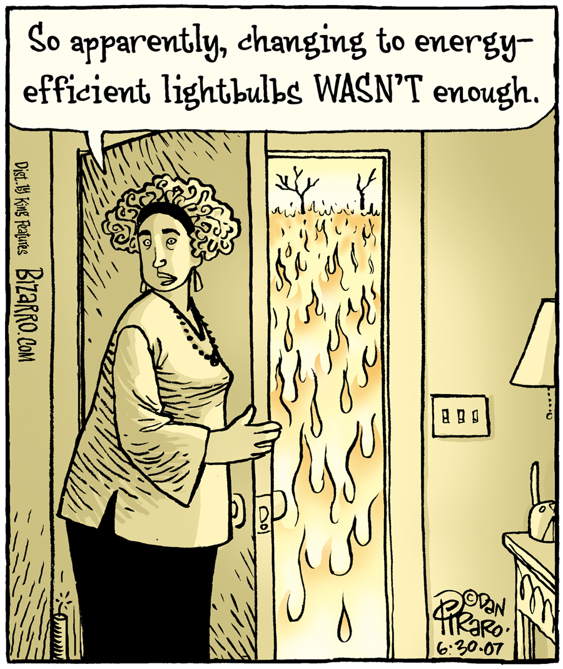
Feedback/Discussion

