Slide 1


Slide 2
Hawai‘i Energy Perspectives and Insights into PY18 Planning
Brian Kealoha & Caroline Carl

Slide 3
PY17 Status

Slide 4
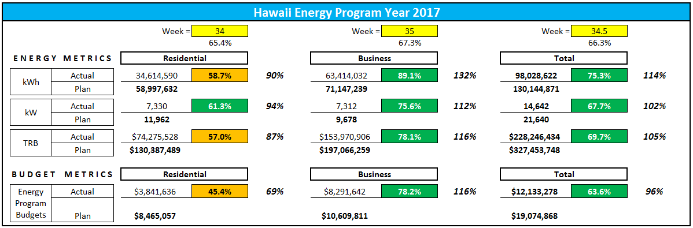
Resource Acquisition
On target to meet kWh, kW and TRB targets
Anticipate residential to business transfer in mid-March

Slide 5
95%
24%
6%
7%
9%

Slide 6
PY18 Planning

Slide 7
TRM Considerations
Residential LED Lighting NTG
  Originally planning for ramp down in PY19, implementing more rapidly for PY18
  Working with program administrators (VEIC), regional groups (NEEA) and indirectly Northeast (MA, RI and CT) program evaluators
Peer Group Comparison
  Diversifying vendor options
  RCT vs. deemed savings

Slide 8
Impact of Changes
Managing portfolio risk in Year 3
Evolving Residential / Business Split
Minimize backslide potential
Preserving relationships with manufacturers, suppliers, distributors, retailers, contractors, and customers.

Slide 9
Reinvesting in Pipeline Development
Forecast subject to significant swings (10+ million kWh)
Cost to acquire savings is increasing
Must reinvest in programs that identify future programs (energy audits, energy studies etc.)
Deeper customer engagements
  Energy program development with business customers
  Strategic energy management with large businesses/institutions
Increasing savings from codes and standards similar to California

Slide 10
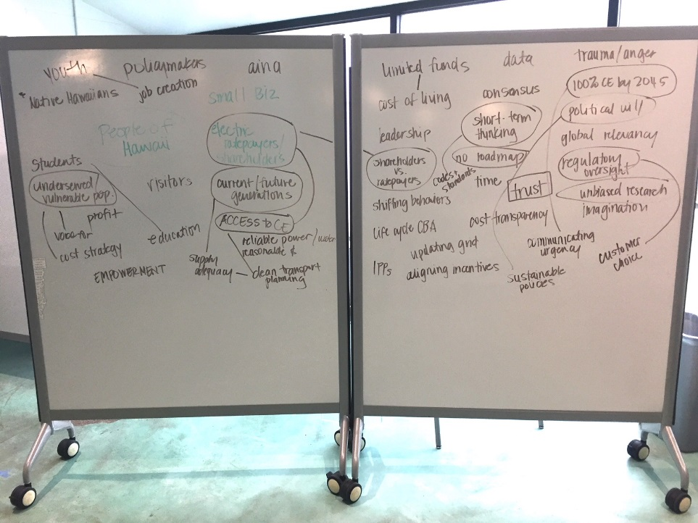
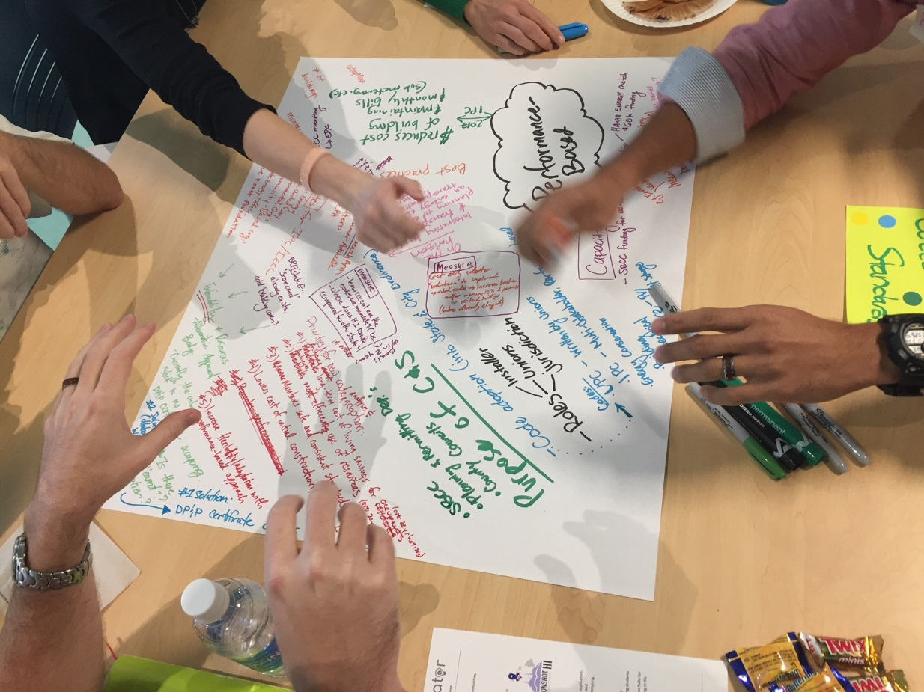
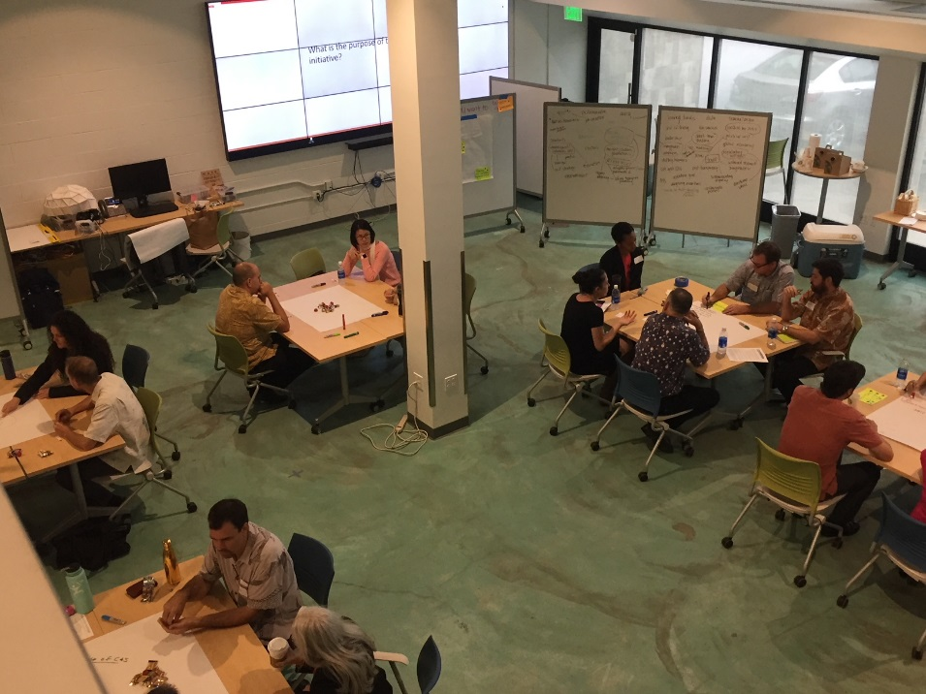
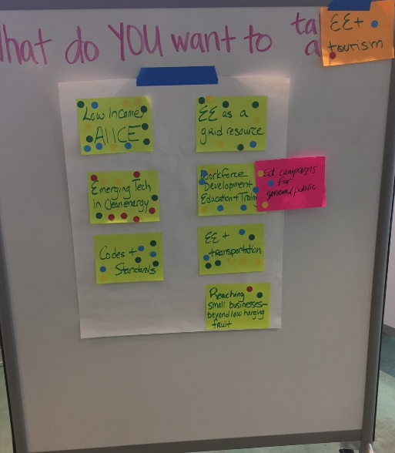
Stakeholder Planning Session

Slide 11
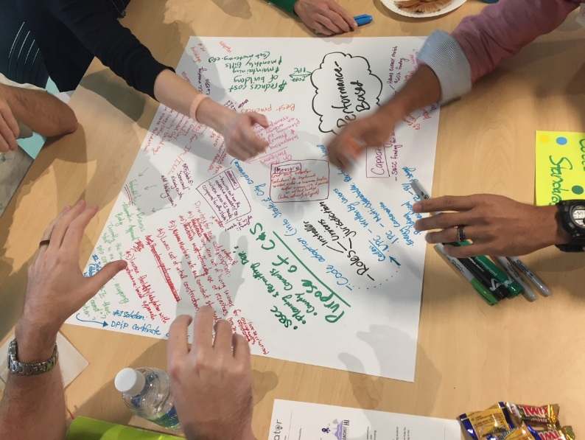
Stakeholder Planning Session
Through these efforts we were able to identify key initiatives that Hawai‘i Energy can implement to drive energy efficiency and economic growth, improve resiliency, and enable a 100% clean energy future. The group work focused on defining the purpose of suggested initiatives, pinpointing specific actions that need to take place in order to enable them, and identifying the metrics that could be used to measure success.

Slide 12
Stakeholder Planning Session – Attending groups
Public Utilities Commission
Consumer Advocate
Hawaiian Electric Company
Maui Economic Development Board
O‘ahu Economic Development Board
Aloha United Way
City and County of Honolulu
Hawai‘i Natural Energy Institute
Chamber of Commerce Hawaii
Kamehameha Schools
Hawai‘i Green Growth
U.S. EPA
Blue Planet Foundation
Ulupono Initiative
Hawaii Center for Advanced Transportation Technologies
Elemental Excelerator
Leidos
Honeywell

Slide 13
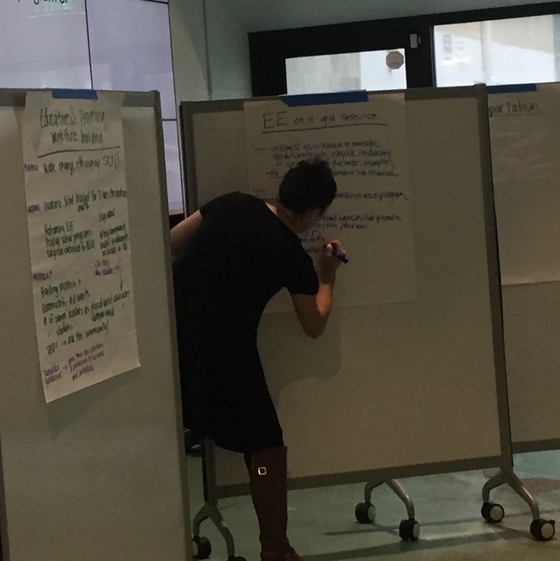
Key areas of focus determined by the group
Low Income / ALICE
Energy Efficiency as a Grid Resource
Energy Efficiency and Transportation
Education and Training / Workforce Development
Codes and Standards

Slide 14



Mahalo!
Stay Connected:
Oahu: 537-5577 (Residential) 839-8880 (Business)
Neighbor Islands: 1-877-231-8222 toll-free
www.hawaiienergy.com
facebook.com/hawaiienergy @myhawaiienergy

